Slide 1
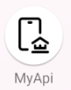
Online Banking Final Project
Jordan Yip
30250615

Slide 2
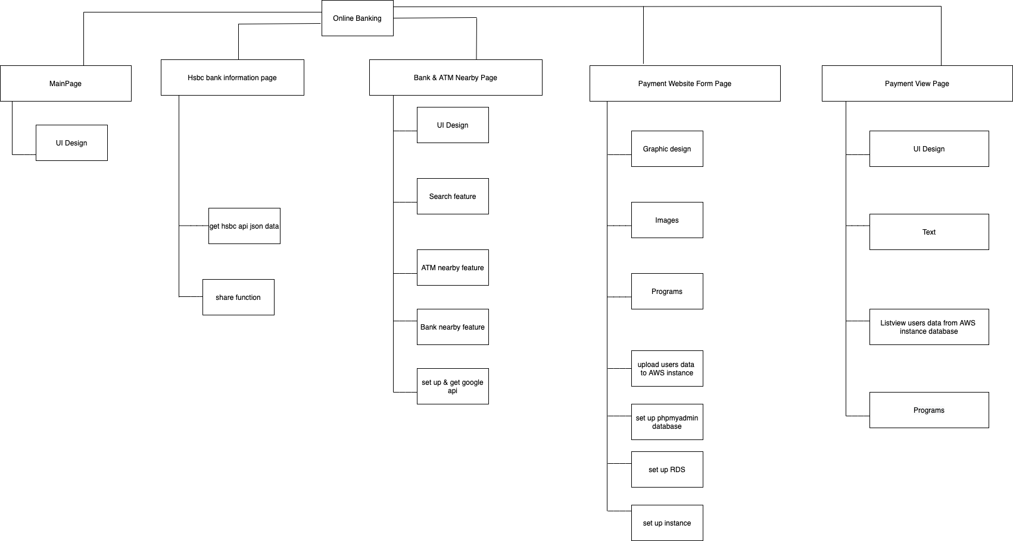
WBS diagram

Slide 3
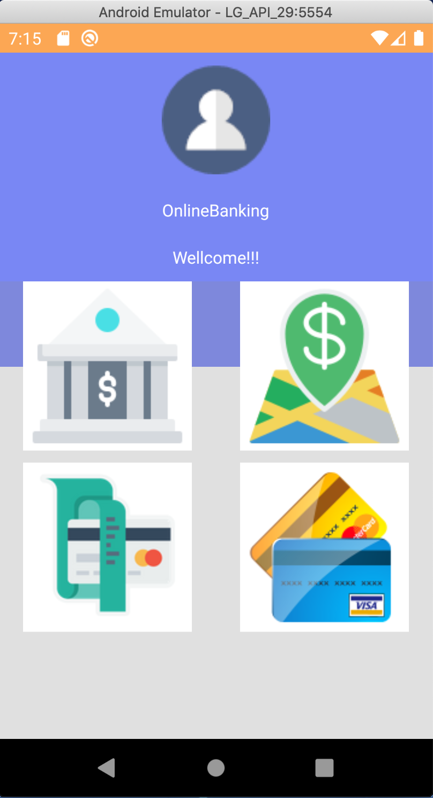
Main Menu

Slide 4
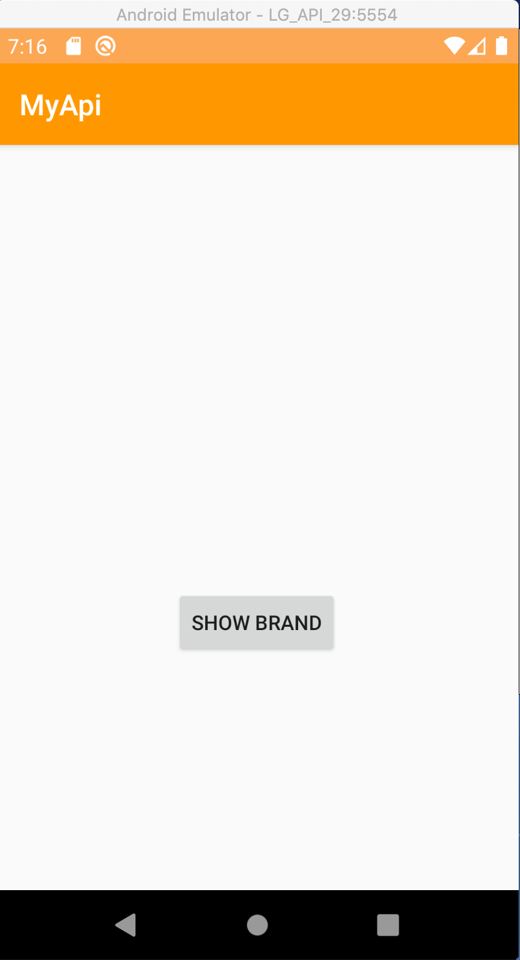
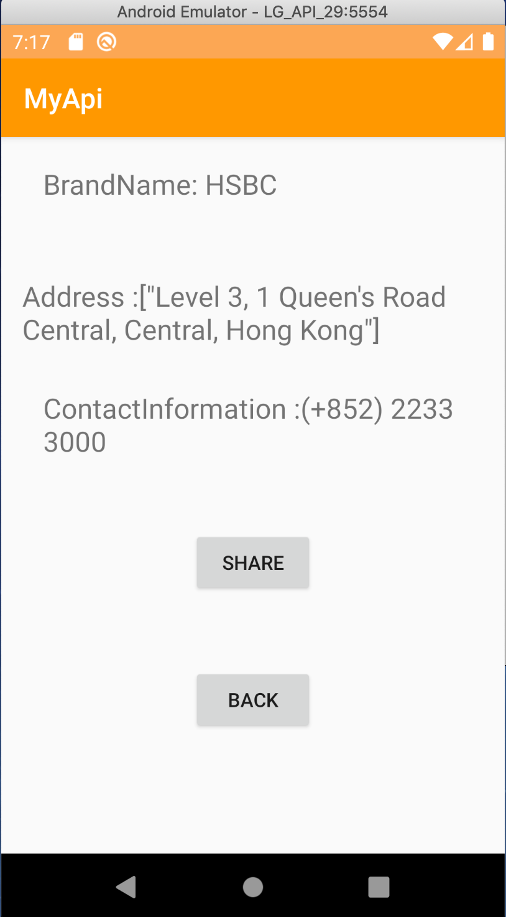
Hsbc open api page Funtion
When you click show bank infor.
References: HSBC open api

Slide 5
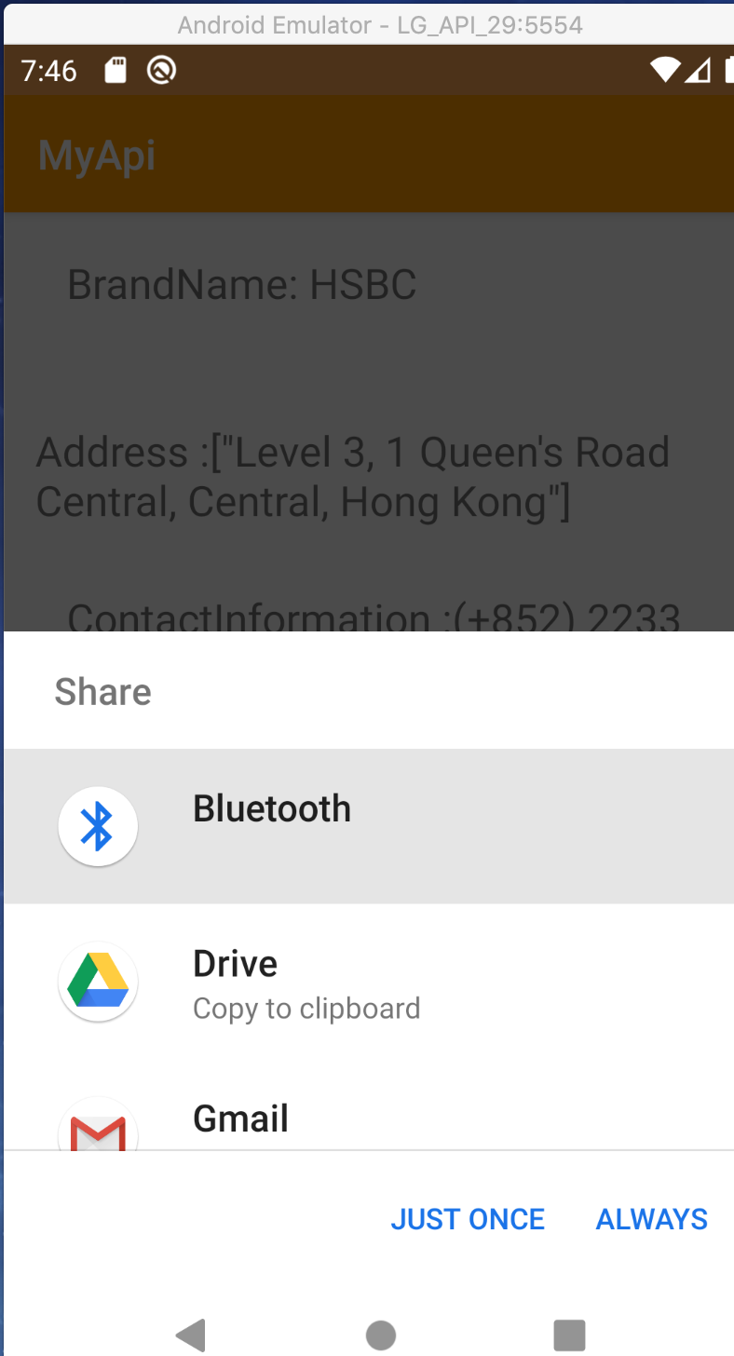
Hsbc open api page Funtion
Click Share button you can though :
Bluetooth
Google drive
Gmail
Click Back button users can back to previous page

Slide 6
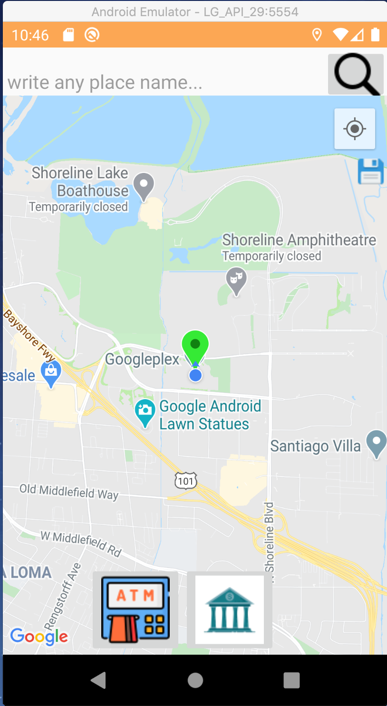
Google Map page
Location button : show users current location automatically
Green marker tells users current location
References: Google map api

Slide 7
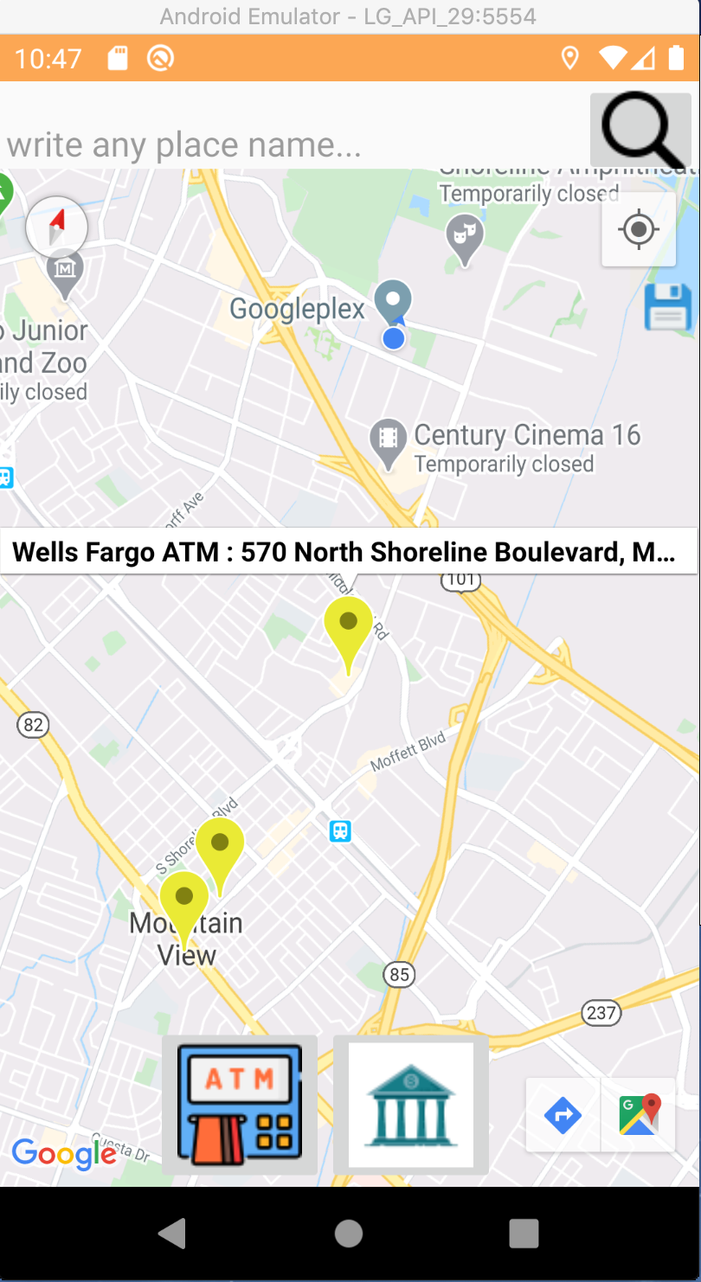
Google Map page
Address of ATM
Some of the yellow marker show the nearest ATM
Users click ATM button show nearby ATM according to users location

Slide 8
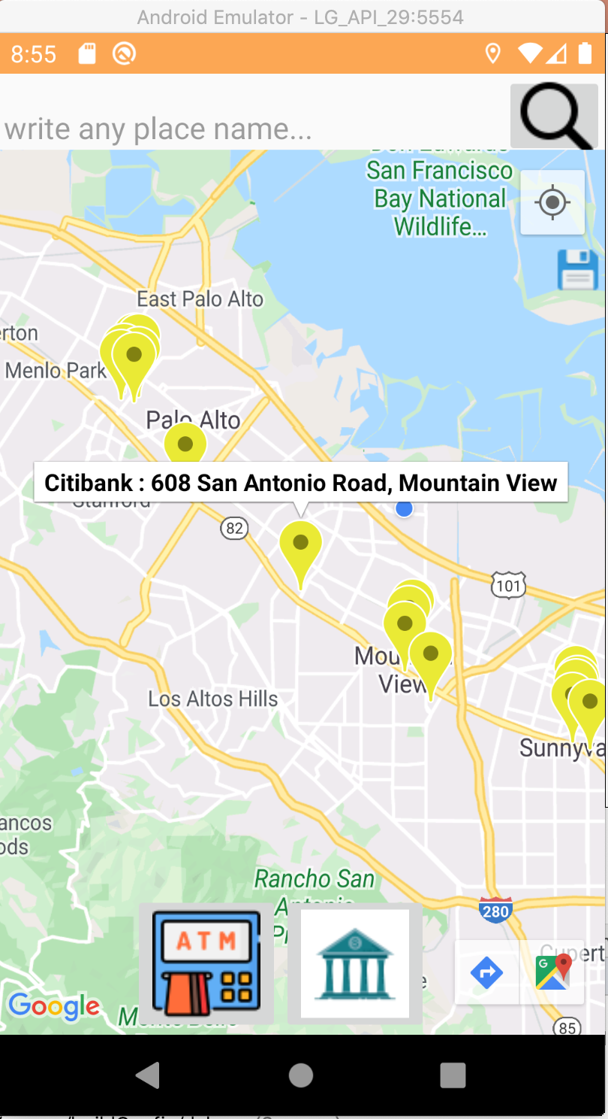
Google Map page
Address of Bank
Some of the yellow marker show the nearest Bank
Users click Bank
button show nearby Bank
according to users location

Slide 9
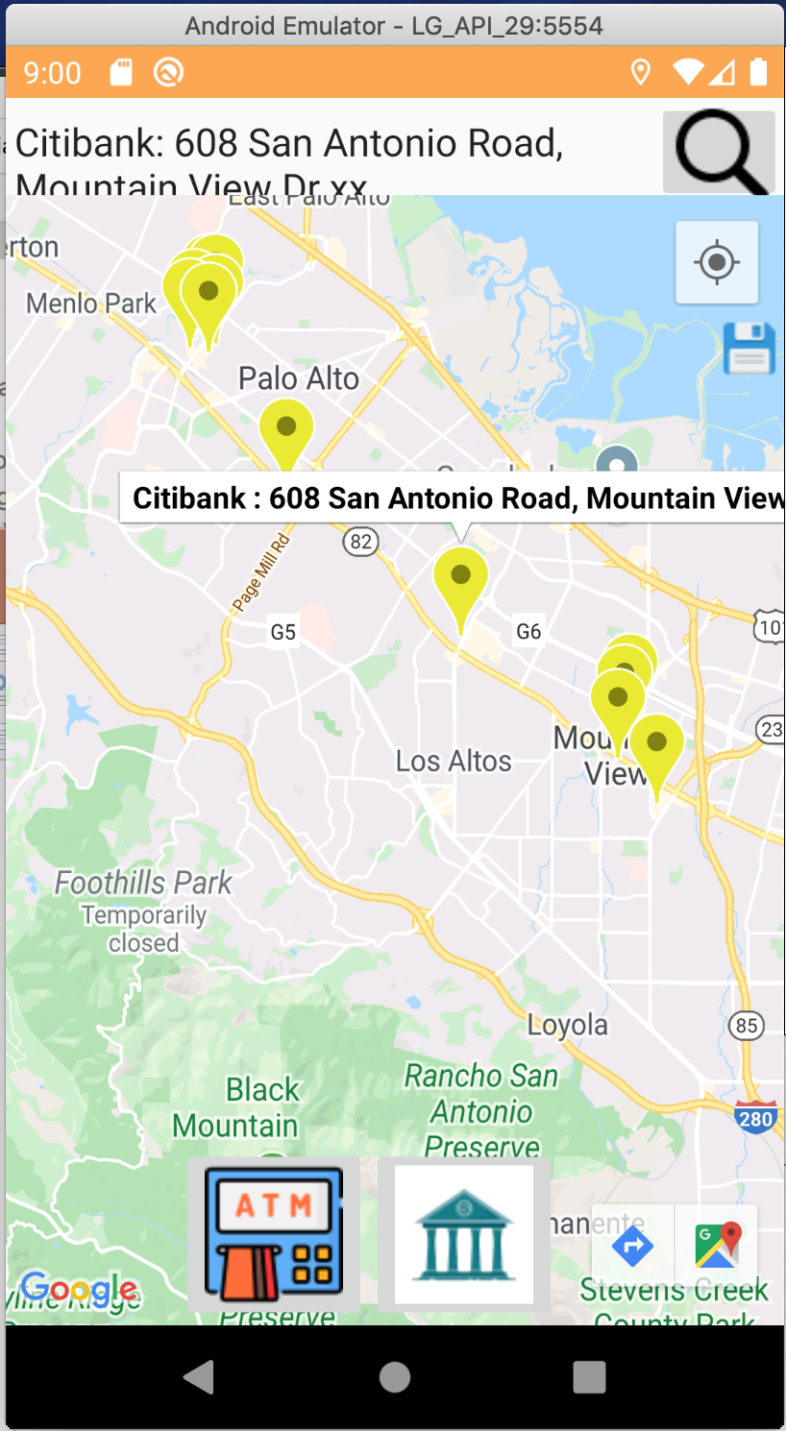
Google Map page
Users can search the bank address search button bar

Slide 10
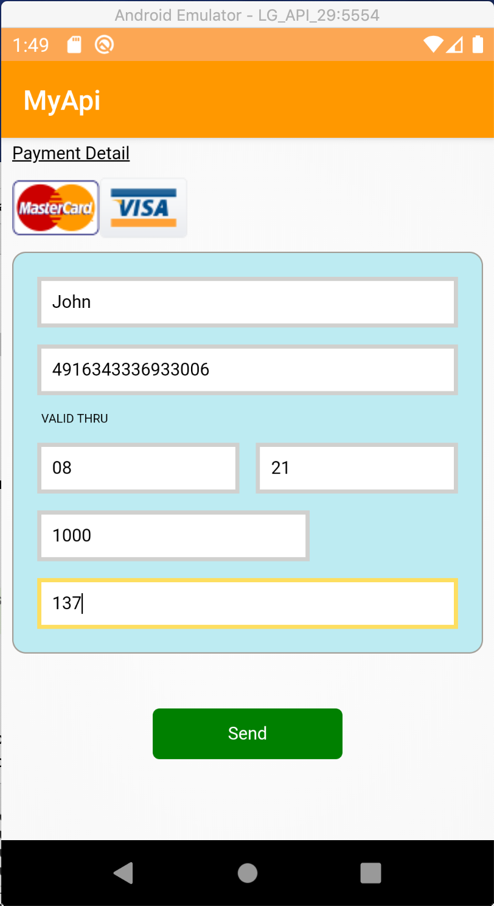
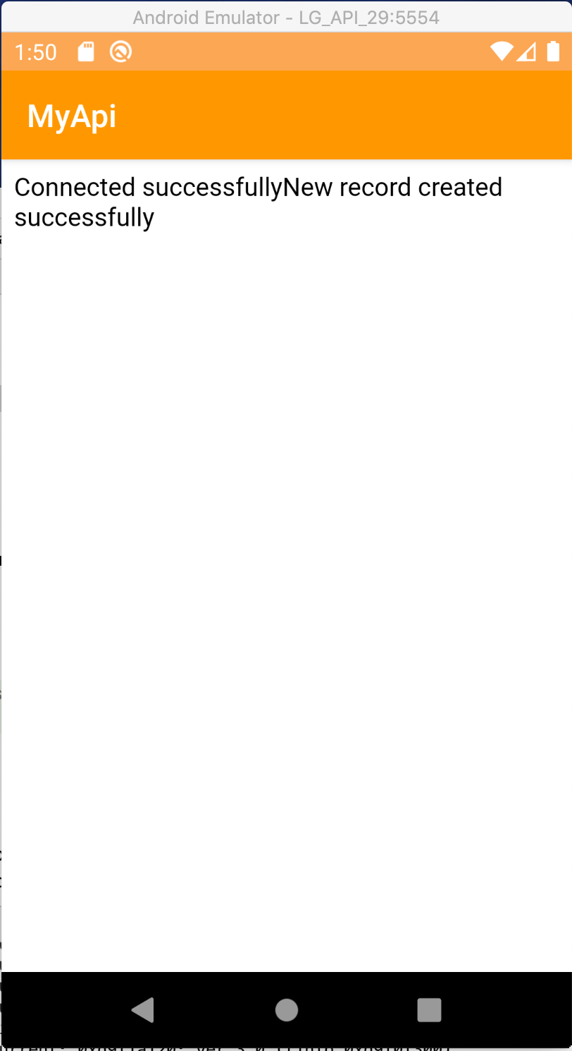
Payment Page
When users input all of the credit card information , all the information will send to Cloud(AWS instance)
References: https://codemyui.com/css-credit-card-payment-ui/

Slide 11
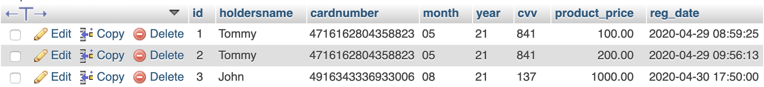


Payment Database table ,RDS and AWS instance

Slide 12
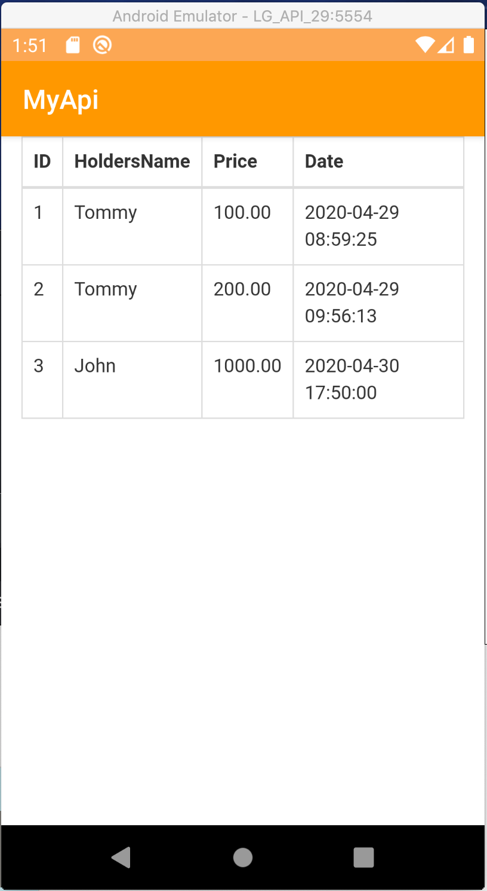
Payment record
This button is use to view users payment
After users go in and the table shows all the payment record like Name, Price as well as Date
References: https://demos.jquerymobile.com/1.4.4/table-reflow/

Slide 13
APP Demo

